Slide 1
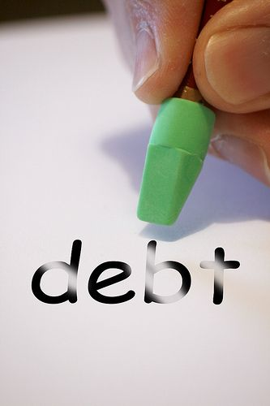

MASTERING DEBT MANAGEMENT
SUBMITTED BY:-
NAME- ABHISHEK VERMA
ROLL NO- 2200680100019
SECTION- A ‘G1’
NAME- Anmol pratap
ROLL NO- 2200680100060
SECTION- A ‘G2’

Slide 2
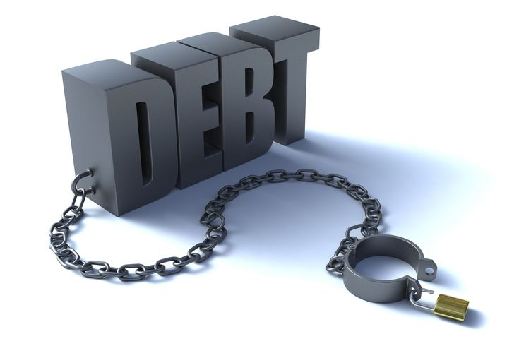

LOGO
ENTER TITLE
WHAT IS DEBT MANAGEMENT?
Debt management is a financial strategy or process that individuals, businesses, or governments use to effectively manage and control their debts. It involves planning, organizing, and monitoring one's financial obligations to ensure that they are paid off in a responsible and sustainable manner.
The primary goals of debt management are to:
--Reduce the burden of debt
--Lower interest costs
--Improve creditworthiness
Avoid default and bankruptcy: By making regular payments and structuring debt appropriately, individuals and entities can prevent defaulting on loans or facing bankruptcy.

Slide 3







WHY IS DEBT MANGEMENT IMPORTANT.
Debt management is crucial for maintaining financial stability and reducing stress. It boosts creditworthiness, lowers interest costs, and ensures timely debt repayment. Effective debt management also safeguards against default and bankruptcy while promoting financial discipline and long-term financial goals.
Domestic air tickets
Domestic Hotel
Train tickets
International air tickets
A foreign hotel
The car

Slide 4
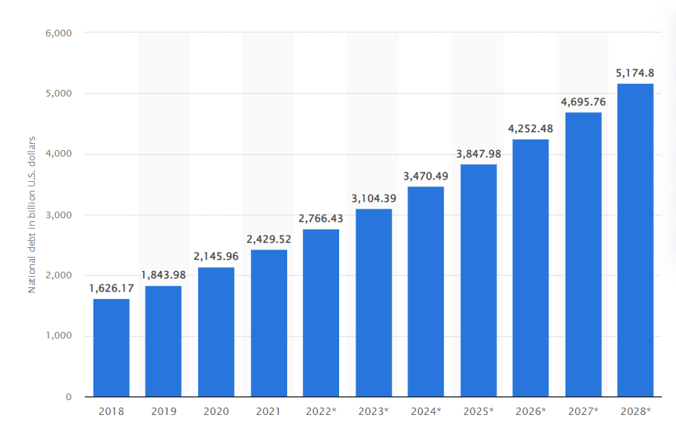
India: National debt from 2018 to 2028(in billion U.S. dollars)
Key cost savings
10%
10%
10%
10%
10%
01 Price undertakings
03 rice undertakings
05 Price undertakings
02 Price undertakings
04 Price undertakings

Slide 5
DEBT REPAYMENT STRATEGIES
DEBT SNOWBALL
This method involves paying off the smallest debts first, regardless of interest rates, while making minimum payments on other debts. As each small debt is eliminated, the freed-up money is applied to the next debt, creating a snowball effect.
DEBT AVALANCHE
With this strategy, you prioritize debts with the highest interest rates. By focusing on high-interest debts first, you minimize the overall interest costs over time while continuing to make minimum payments on other debts.
DEBT CONSOLIDATION
Combining multiple debts into a single, lower-interest loan can simplify payments and reduce overall interest costs. Common consolidation methods include personal loans, balance transfer credit cards, or home equity loans.

Slide 6

Debt consolidation
Introduction
WHY use debt consolidation.
Debt consolidation is a financial strategy where you merge multiple high-interest debts into a single, more manageable debt. This can be achieved through a lower-interest personal loan, a balance transfer to a credit card with a lower introductory rate, or by using your home equity to secure a loan.
The benefits often include lower interest rates, simplified payments, improved credit scores if managed responsibly, and a structured debt repayment plan. However, it's essential to consider your creditworthiness, potential fees, and your financial discipline, as well as any collateral involved, before pursuing debt consolidation. It should be part of a comprehensive financial plan.

Slide 7

CREDIT COUNSELING
CREDIT COUNSELING is a service provided by nonprofit organizations and agencies to help individuals and families manage their personal finances, reduce debt, and improve their financial literacy. some key points of credit counselling are:
1. Financial Assessment
2. Debt analysis
3. Budgeting and Financial Planning
4.Debt Management Plan (DMP)
5.Credit counseling offers financial education and helps improve credit scores, consolidate debts, and negotiate with creditors.

Slide 8
HOW CAN WE MASTER DEBT MANAGEMENT
Acess your financial situation
Start by understanding your current financial position, including your total debt, interest rates, and monthly obligations.
Set Clear Goals
Create a budget
Define specific, achievable goals for debt reduction. Having clear objectives can motivate and guide your debt management efforts.
Develop a realistic budget that outlines your income, expenses, and debt payments. A budget helps you allocate funds for debt reduction.
Reduce Expenses
Prioritize Debts
Trim unnecessary expenses to free up more money for debt payments. This might involve cutting non-essential spending and finding ways to save on everyday costs.
Identify high-interest debts and prioritize paying them off first. Consider using the debt avalanche or snowball method.

Slide 9



TECHNOLOGIES USED

Slide 10
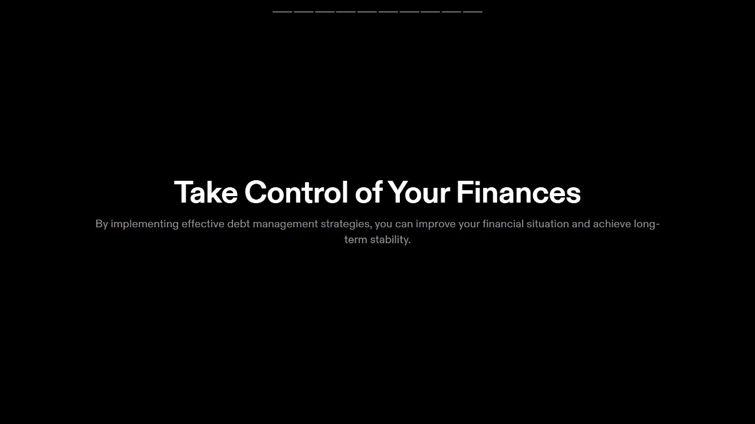

01
03
Ticket Solution
02
04
The Hotel Solution
Huiwu Solutions

Slide 11

THANKS

